Slide 2
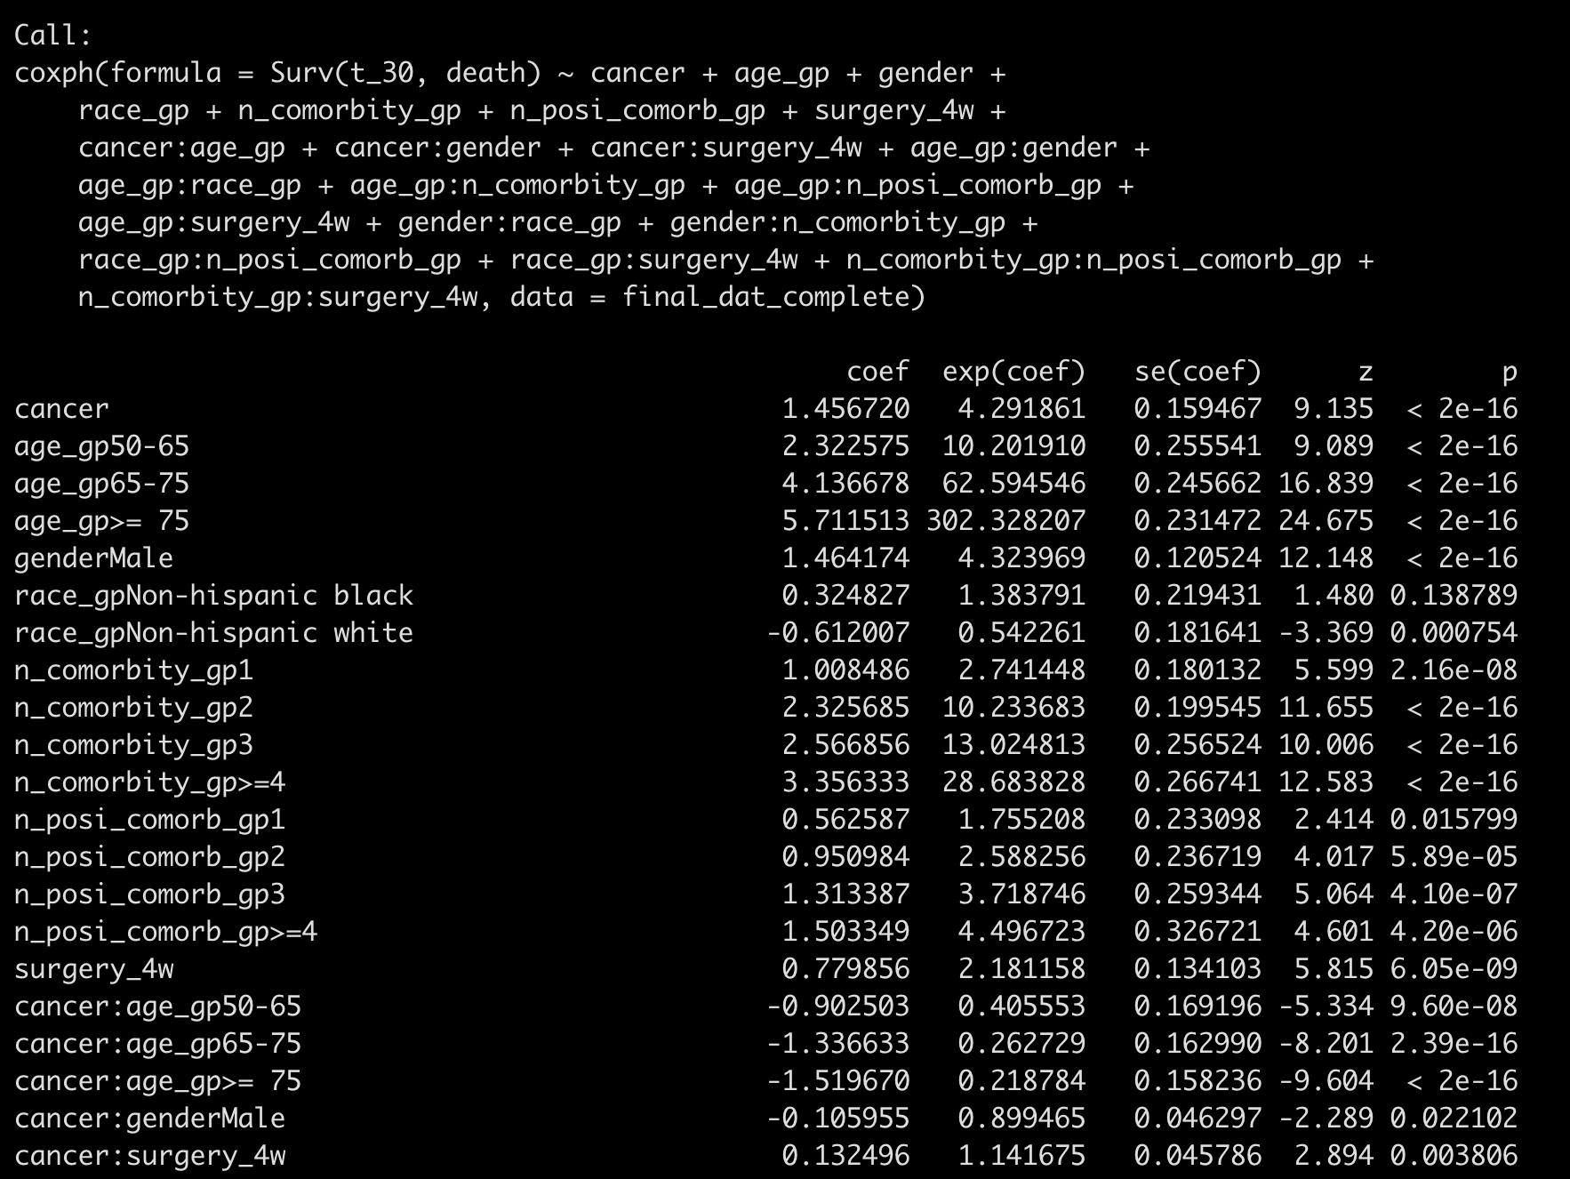
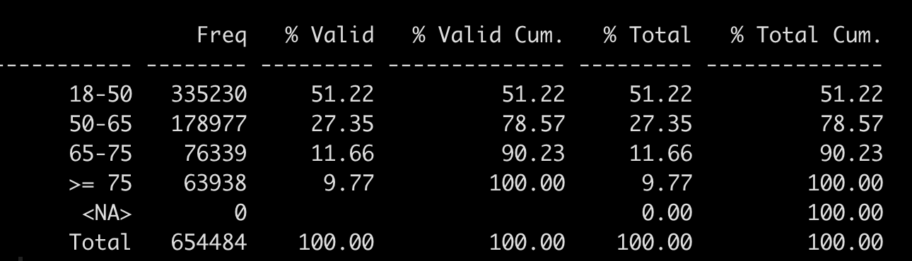
Backward-AIC from all two-way interactions:
50-65: exp(1.457 – 0.903) = 1.74
65-75: exp(1.457 – 1.337) = 1.127
>= 75: exp(1.457 – 1.520) = 1
Maybe remove this one?

Slide 3
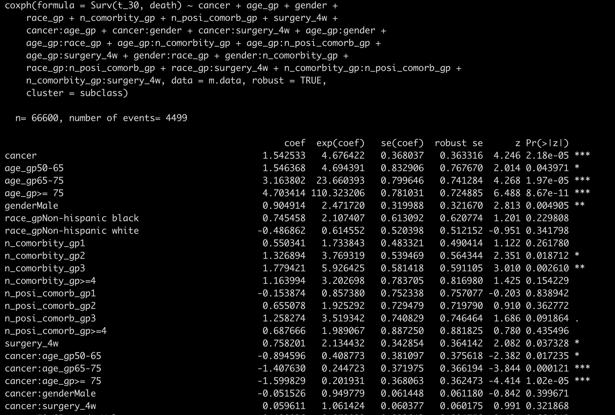
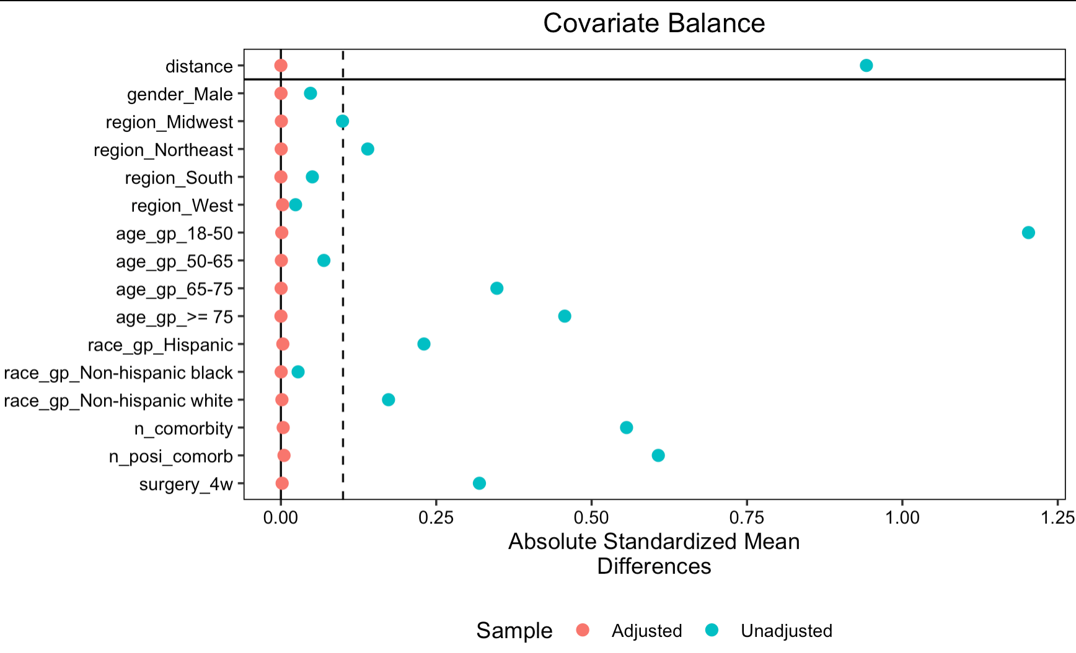
PSM matched on all two-way interactions

Slide 4
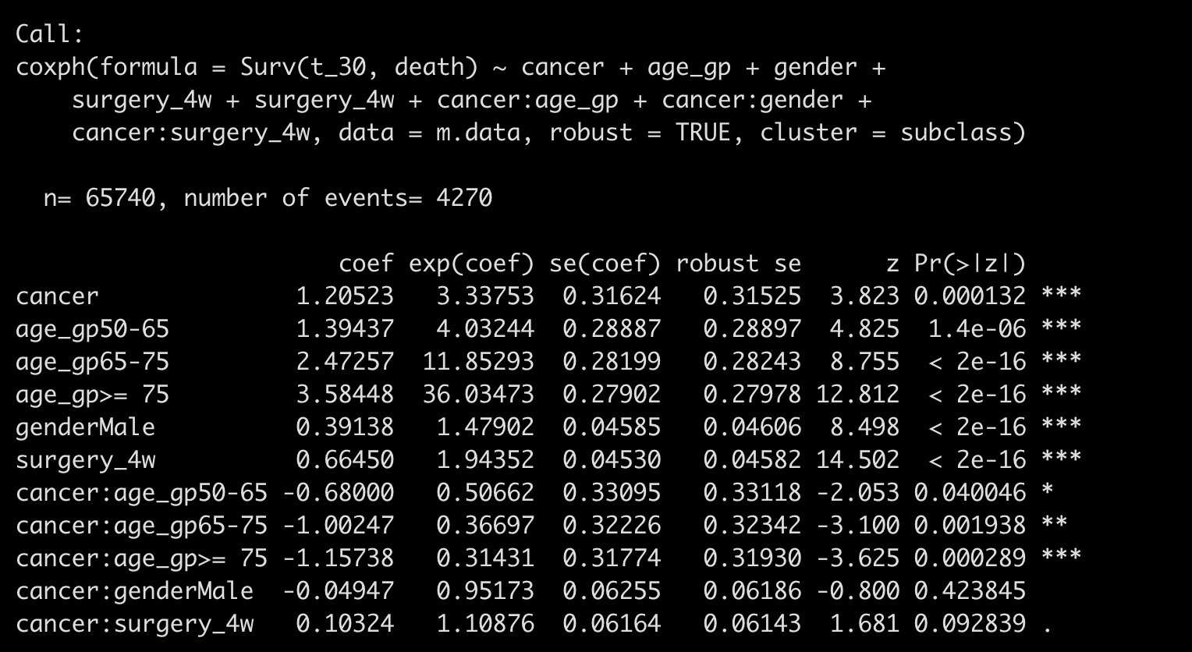
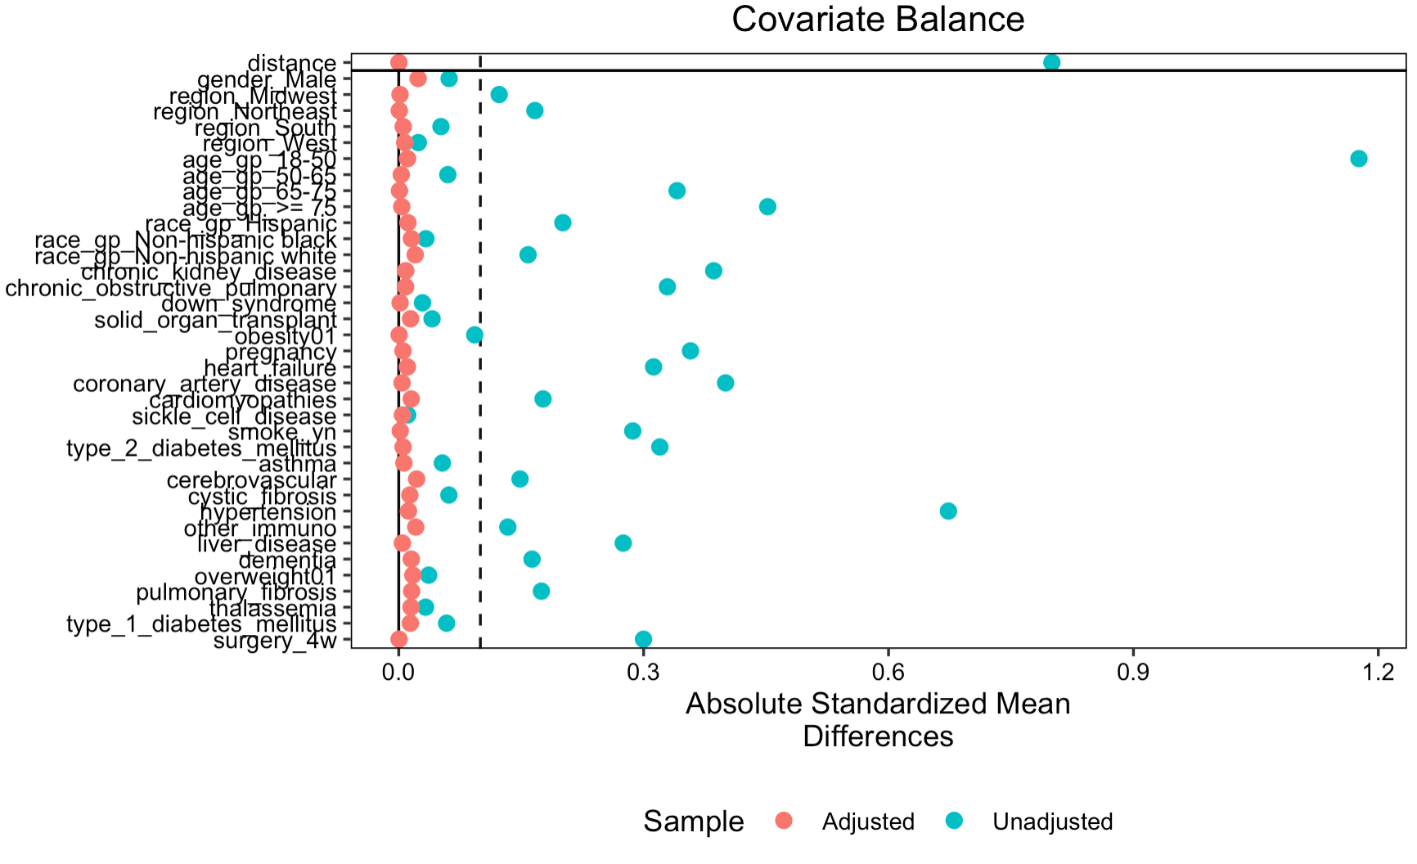
PSM matched on individual comorbidity level

Slide 5
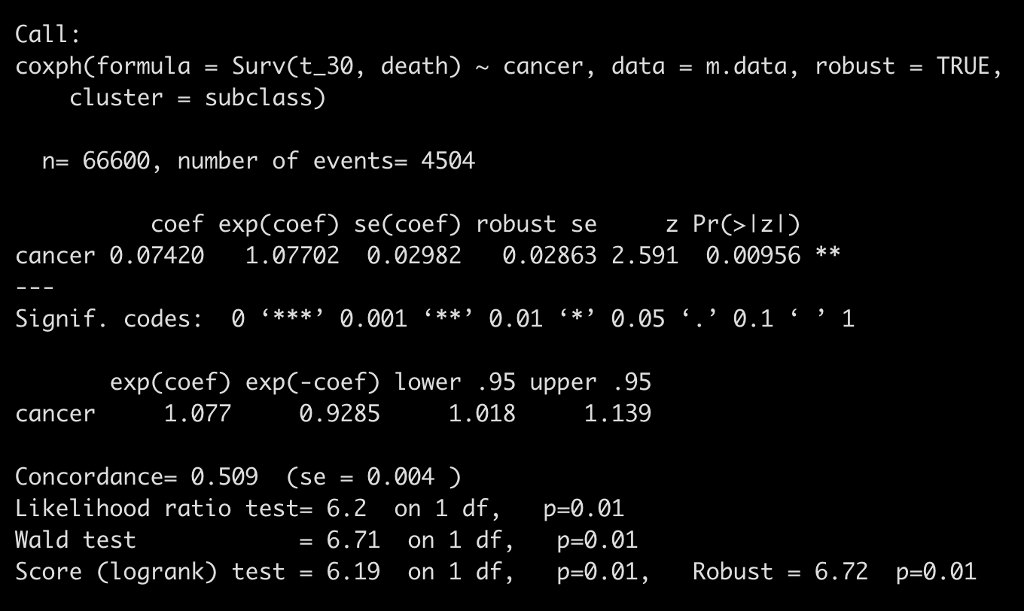
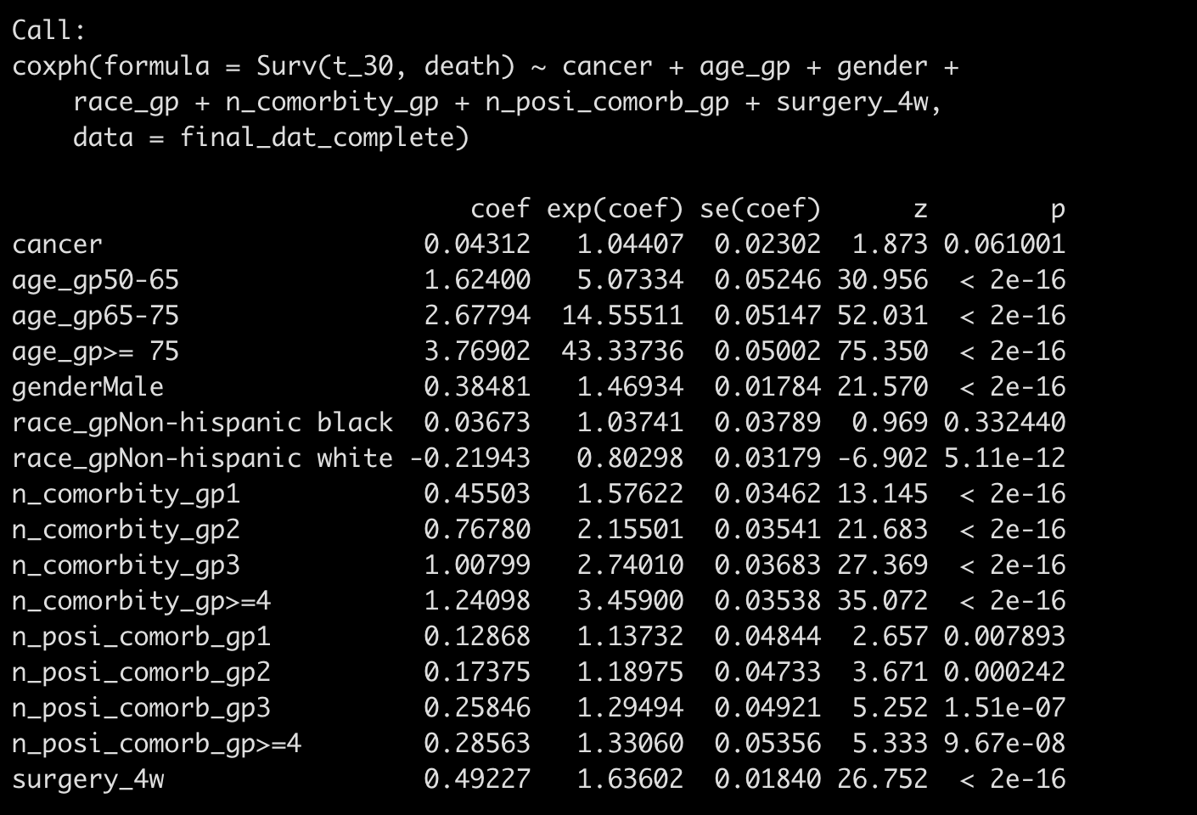
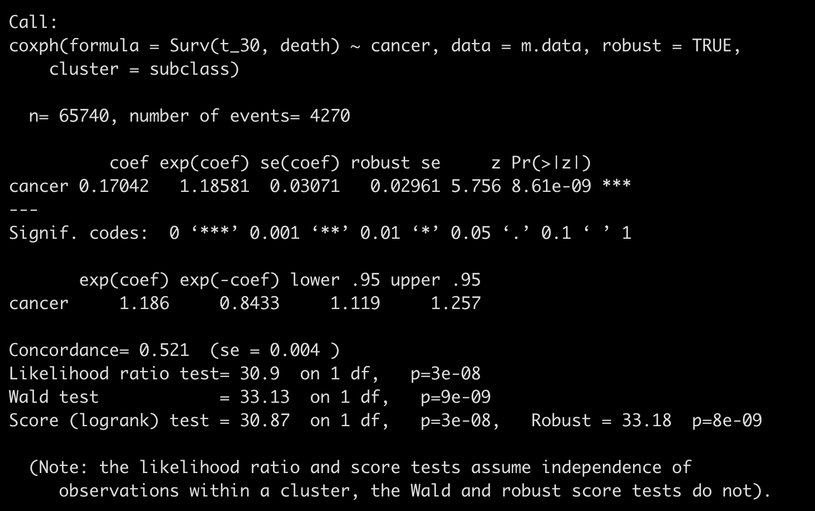
Without consider interaction
Average treatment effect in treated
Average effect in an unknown population

Slide 6
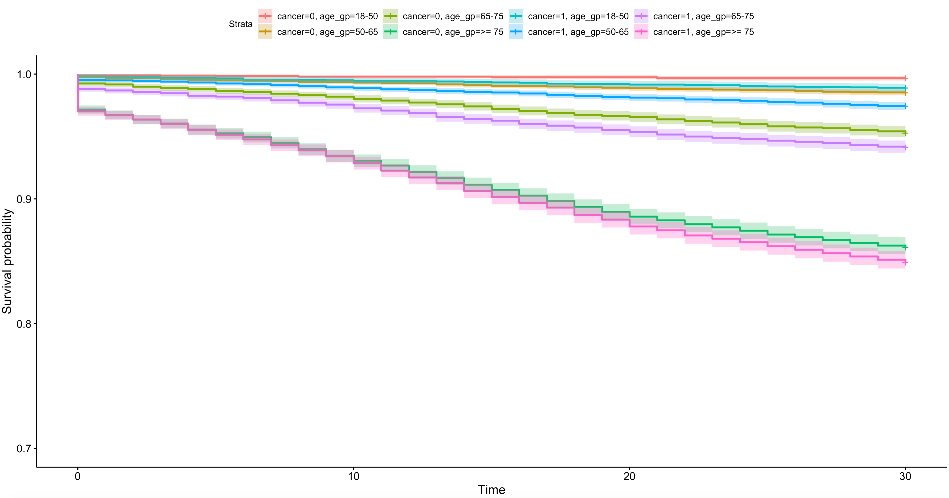

Slide 7
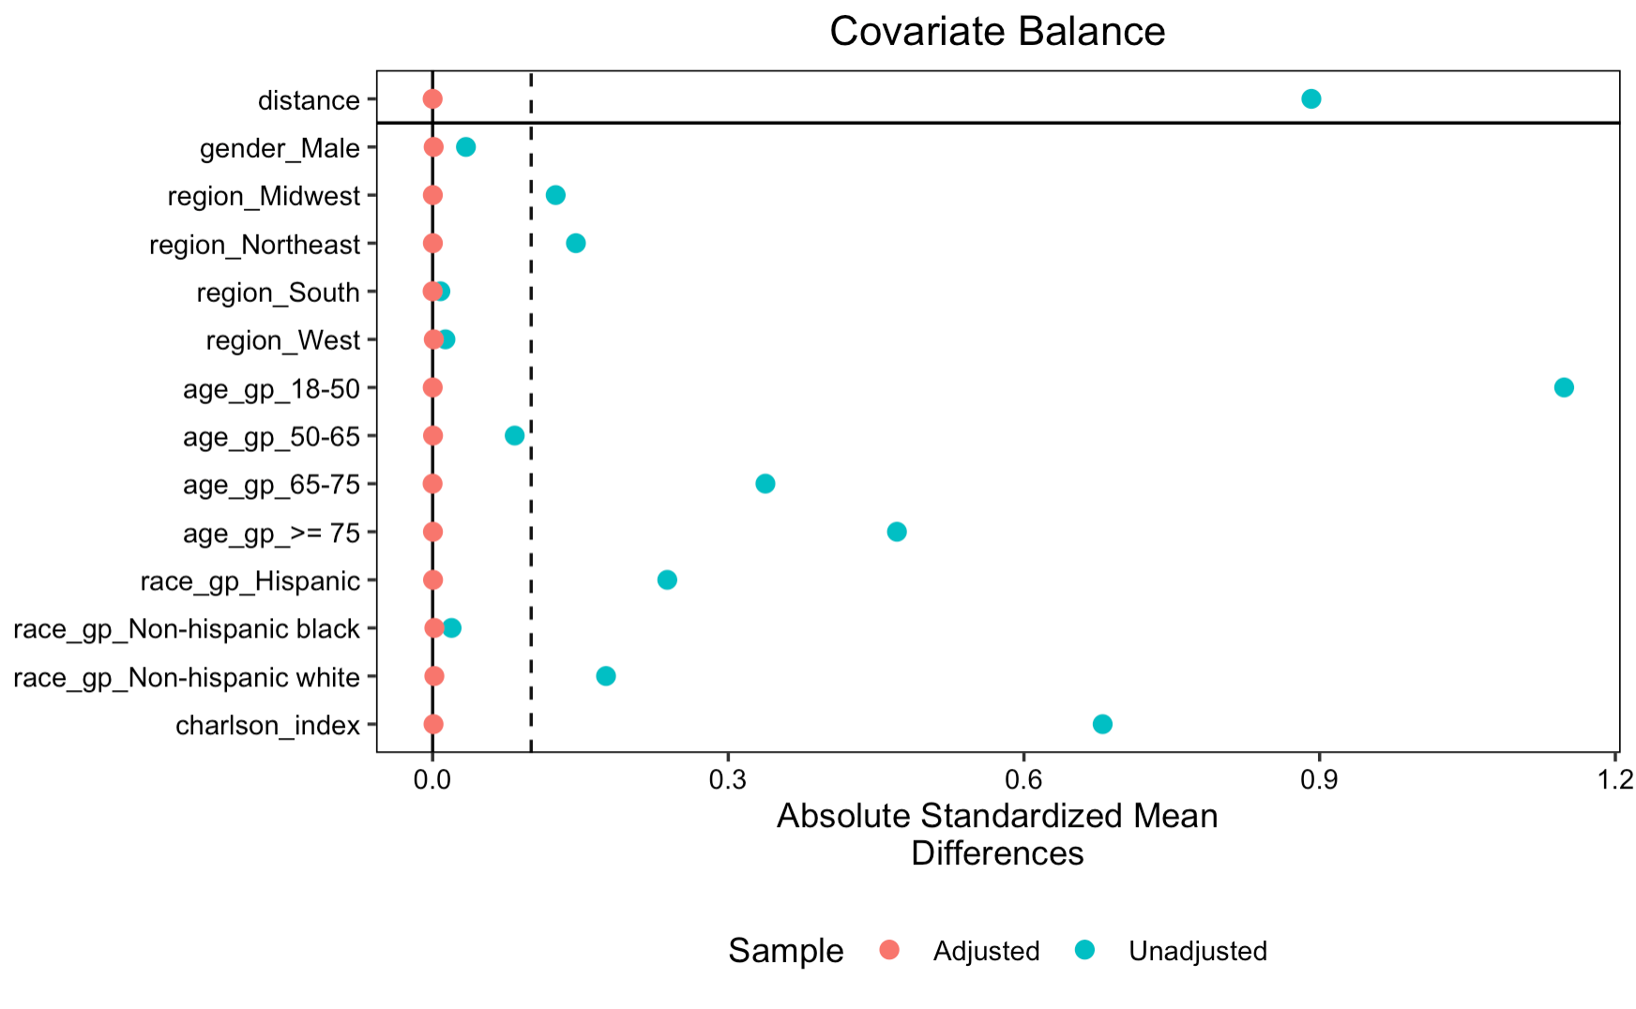
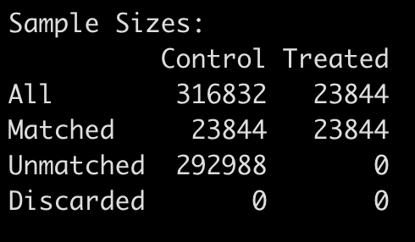

Slide 8
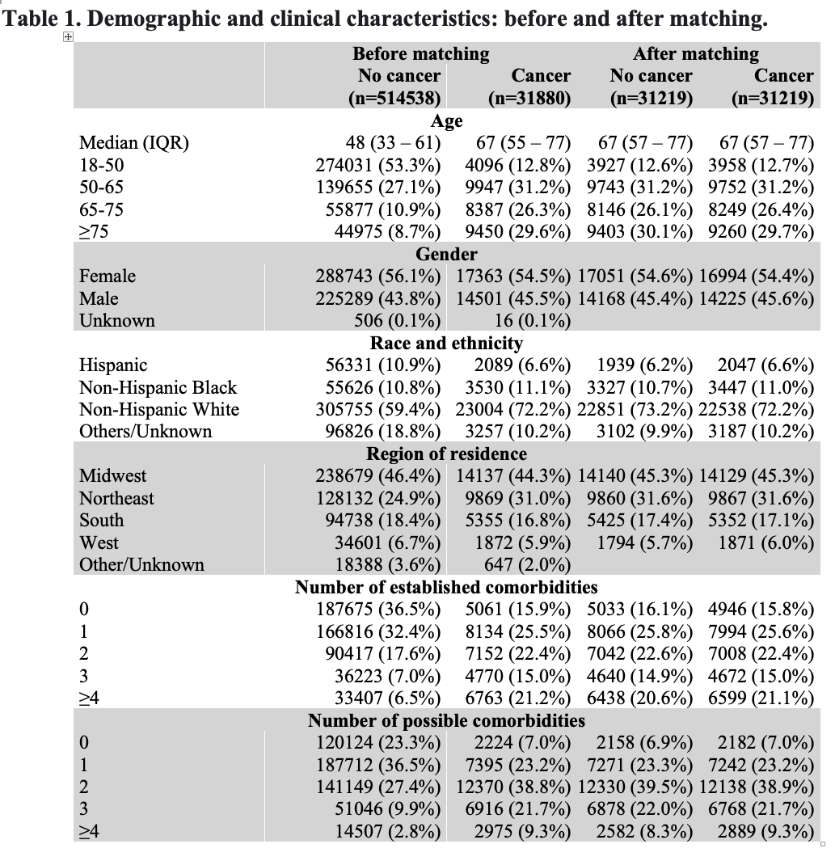
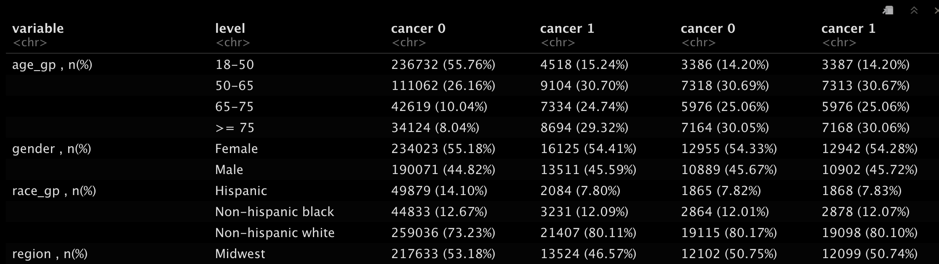
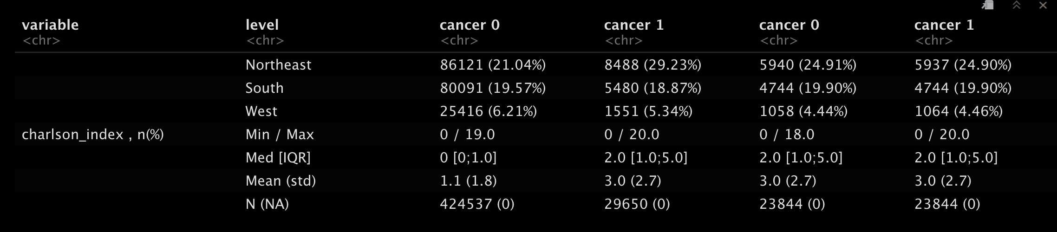
Other/Unknown will be treated as missing
Notes:
Missing whether to present it in the table

Slide 9
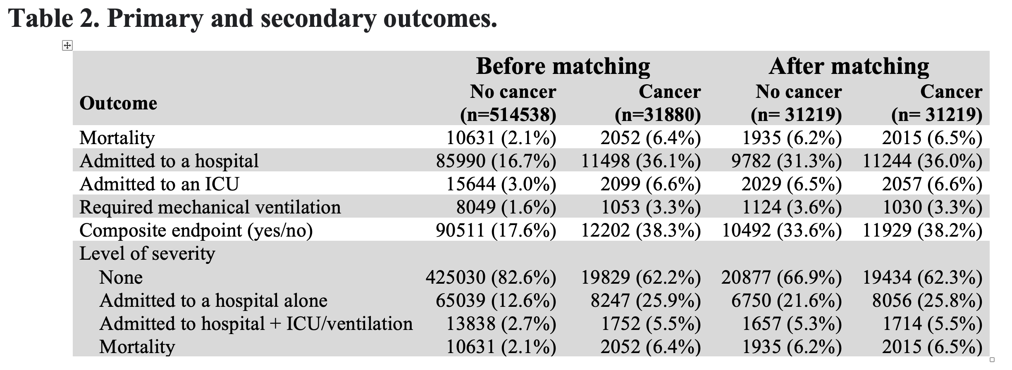
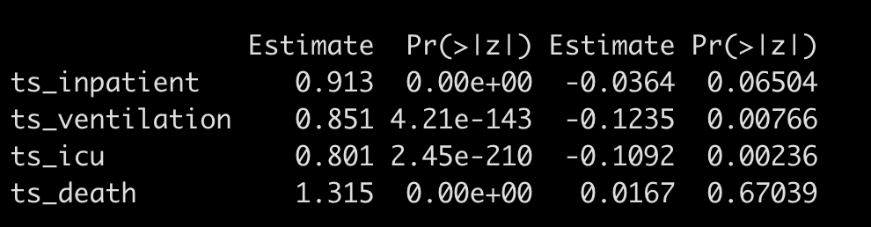
simple logistic regression
logistic regression using PSM

Slide 10
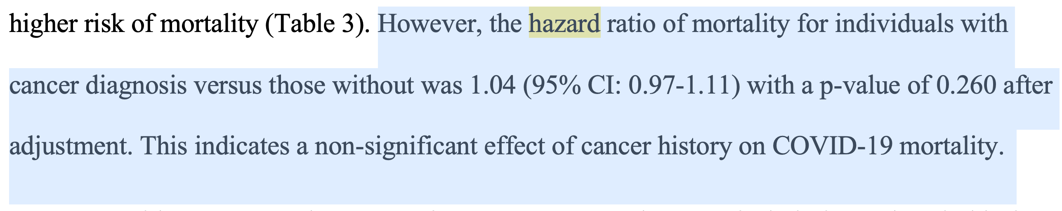
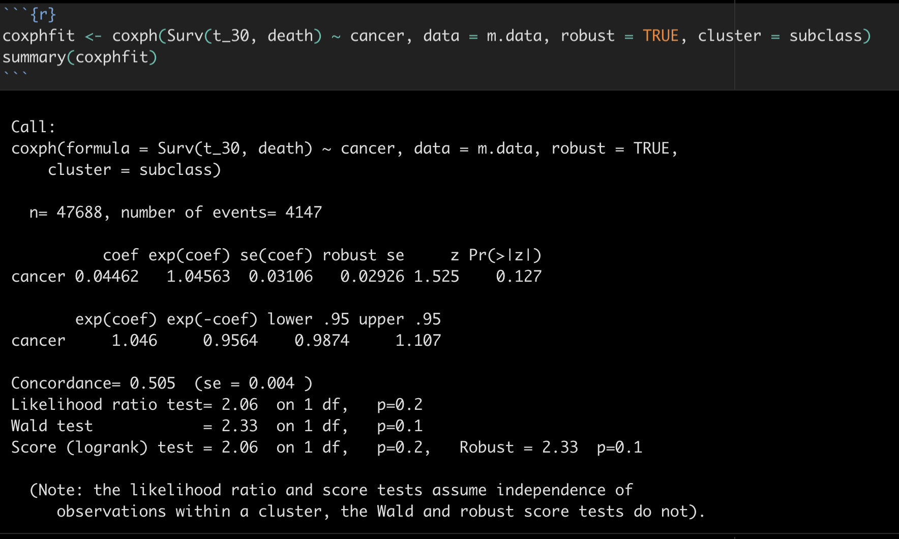
Survival analysis (time-to-event calculation is questionable)

Slide 11
Cancer subgroup analysis
One or two table

Slide 12
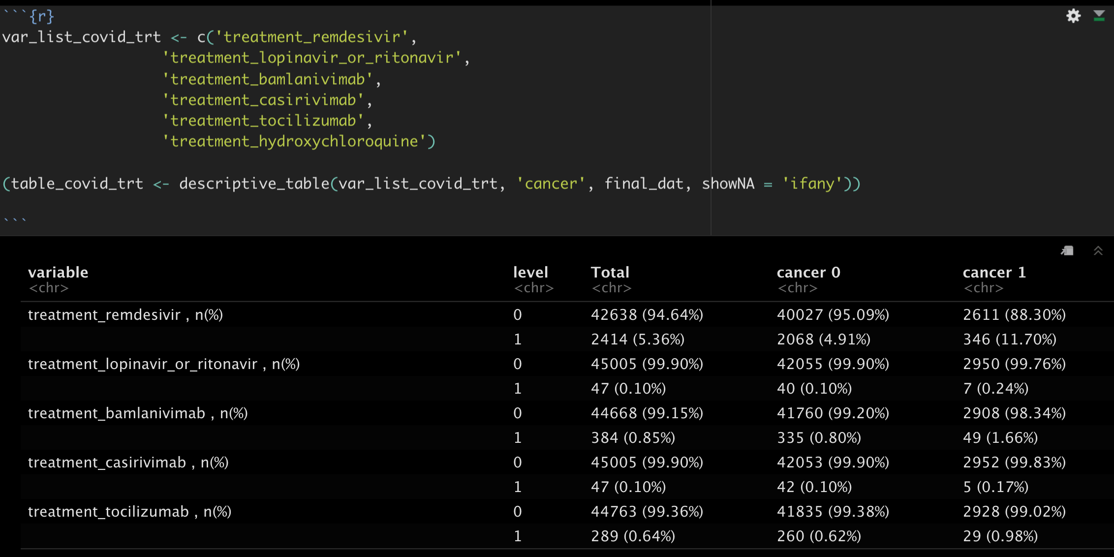

Slide 13
Check list
What comorbidity will be used? Whether to use Charlson comorbidity index.

Slide 14
Few modification
use n_comorbity_gp, n_posi_comorb_gp as categorical variable instead of n_comorbity, n_posi_ comorb as continuous variable
Age_gp was used instead of age as a continuous variable
Surgery_4w was used in matching

Slide 15
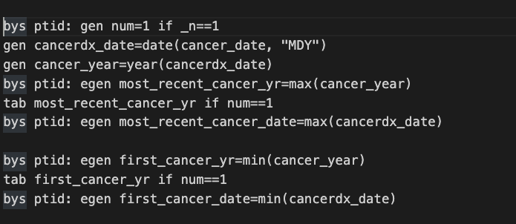
How cancer date and cancer_dx_code is used?
The earliest cancer date? And the cancer code corresponding to it?

Slide 16
The hospitalization is the old “inpatient” variable?

Slide 17
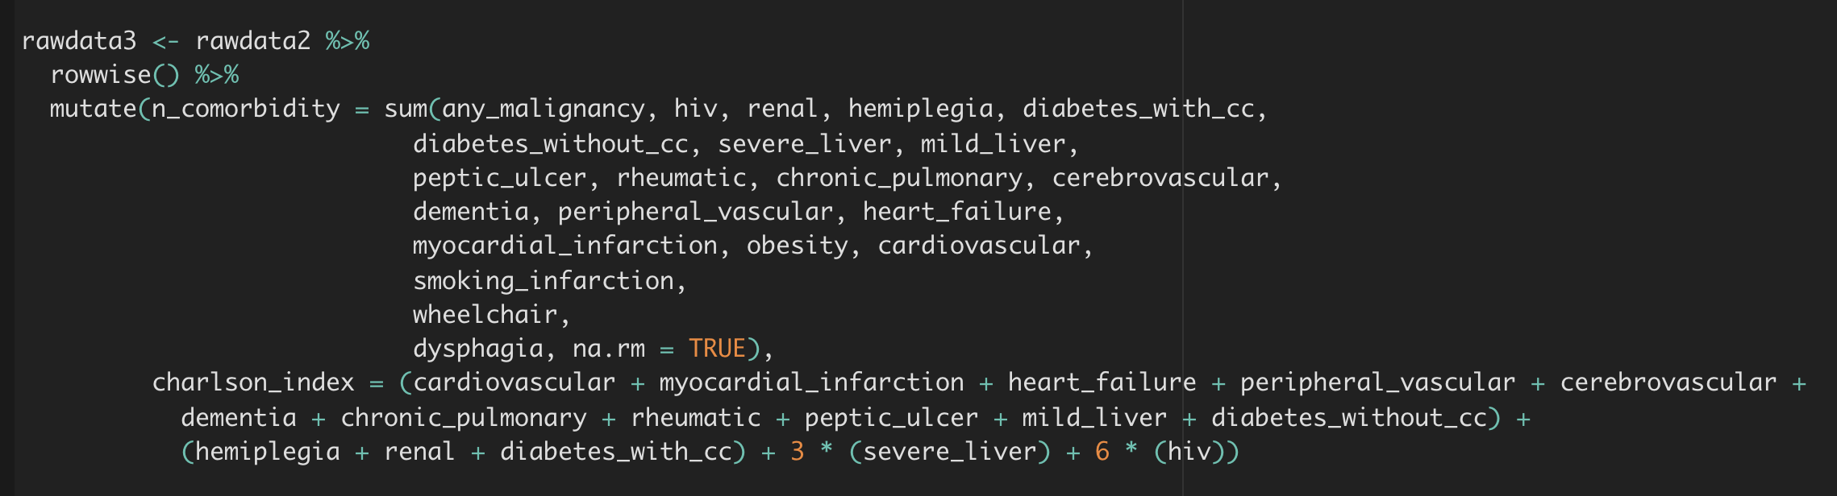
Which comorbidity to use? And whether to use Charlson comorbidity index

Slide 18
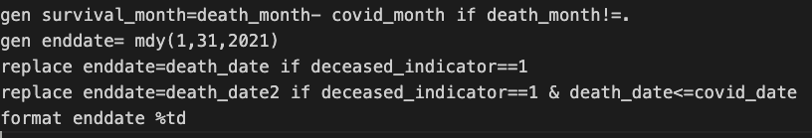
Does the data should based on version 01/28

Slide 19
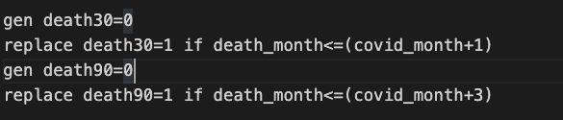
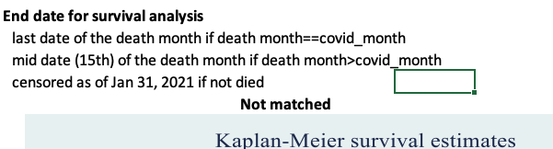
Some question about survival analysis
Death30 could be death between 0-60 days
Jun 25 – last record :July 1 death: July 1

Slide 20
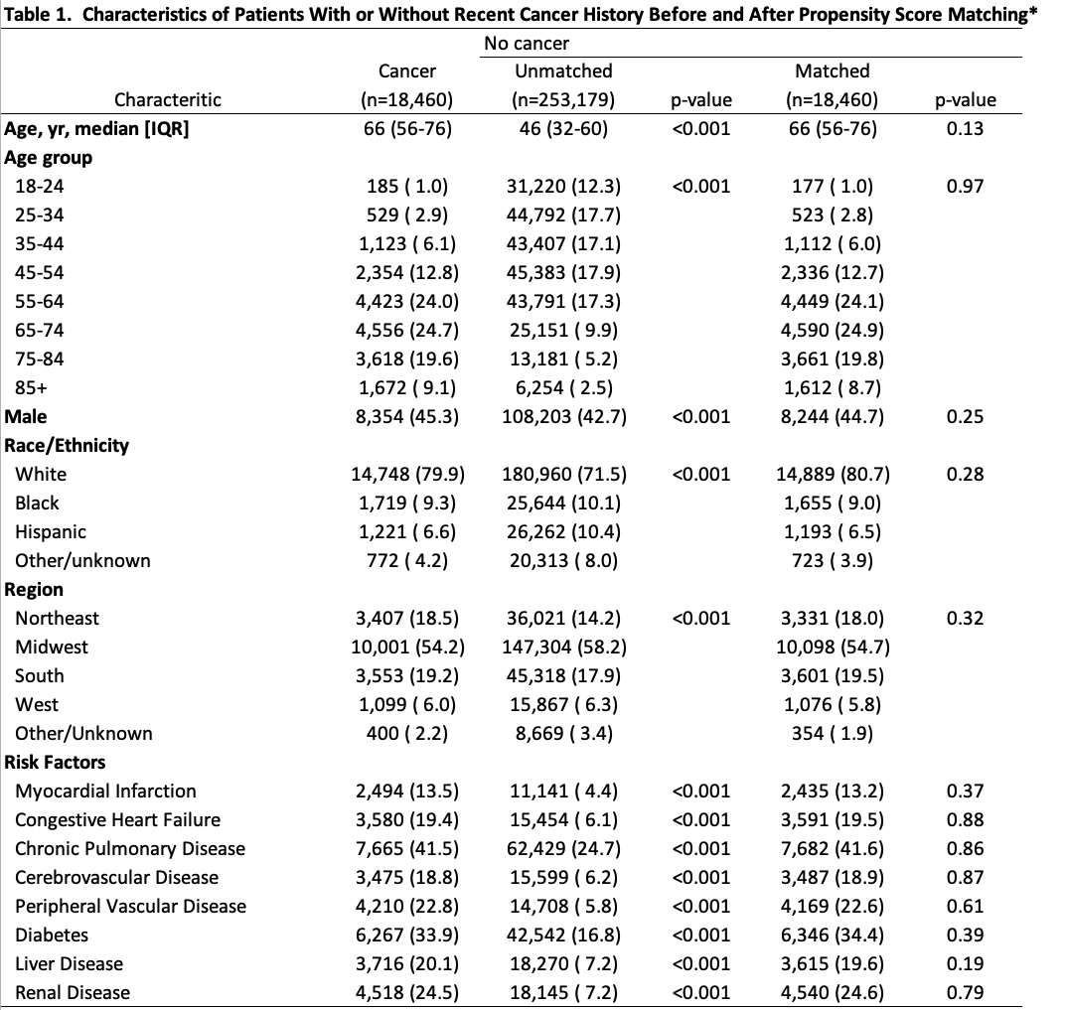
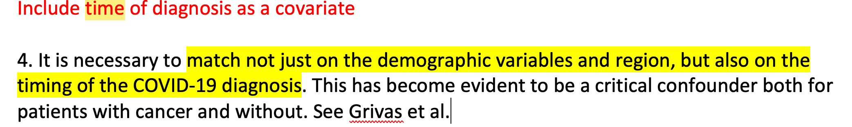
Comments: include covid diagnosis date as a covariate
Add Dementia, obesity to covariates
use Cardiovascular only instead of myocardial.

Slide 21
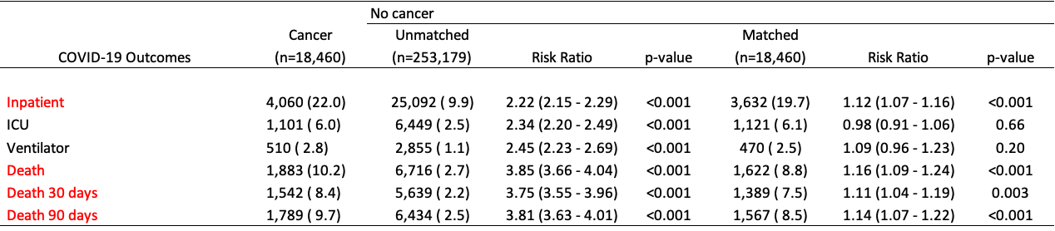
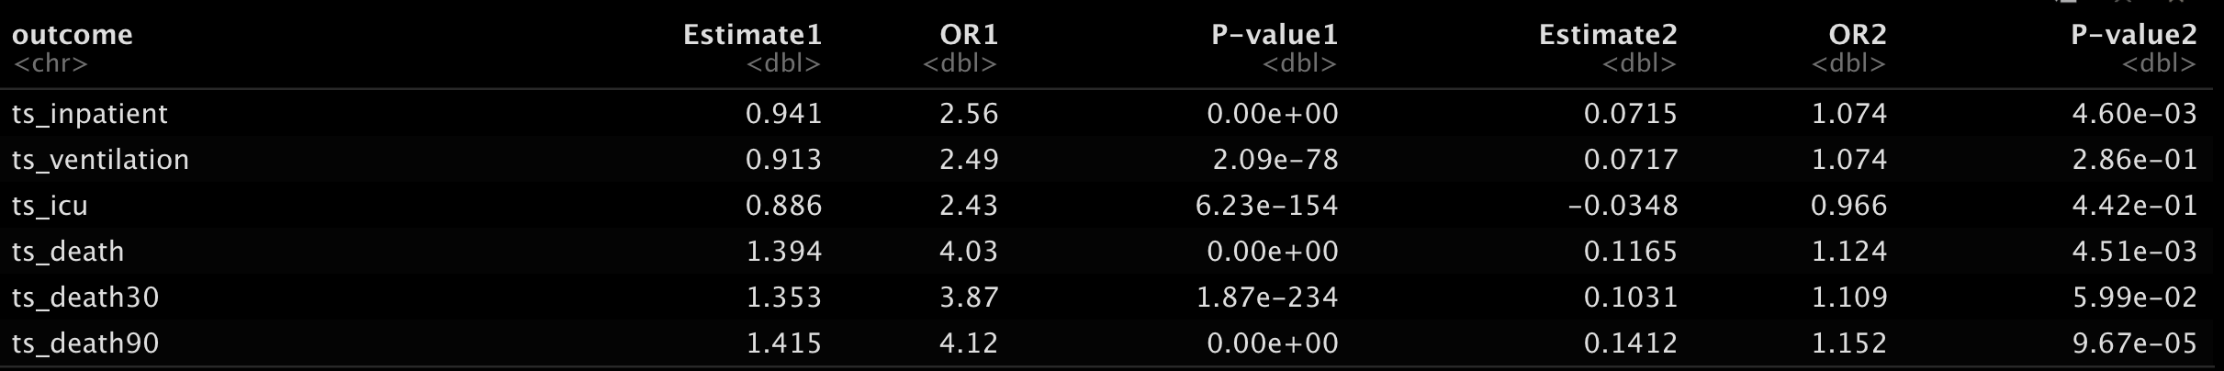

Slide 22
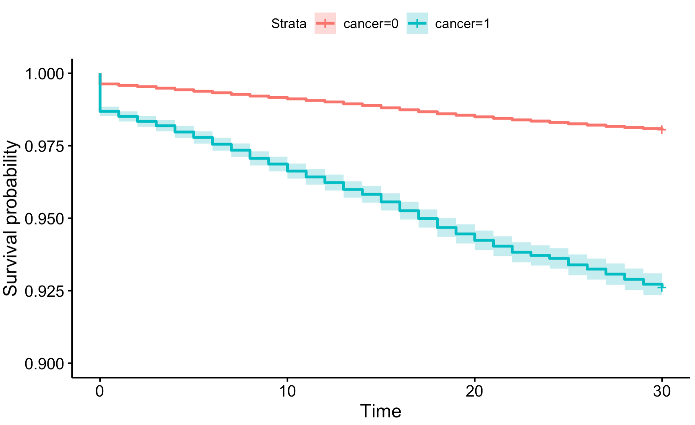
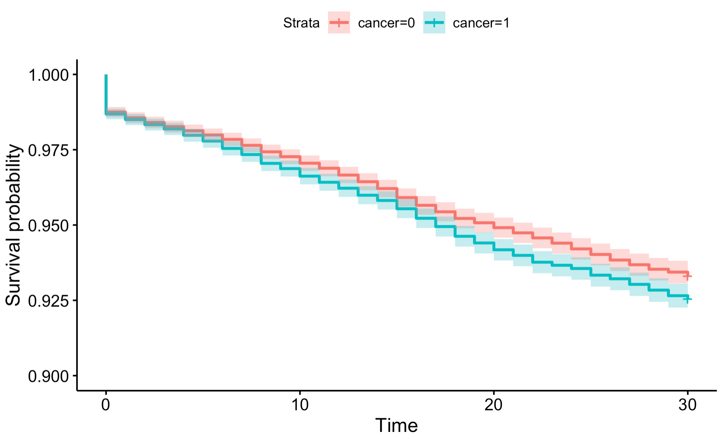
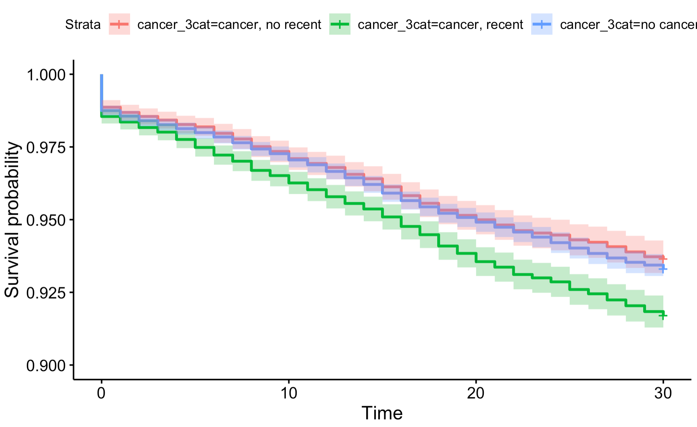
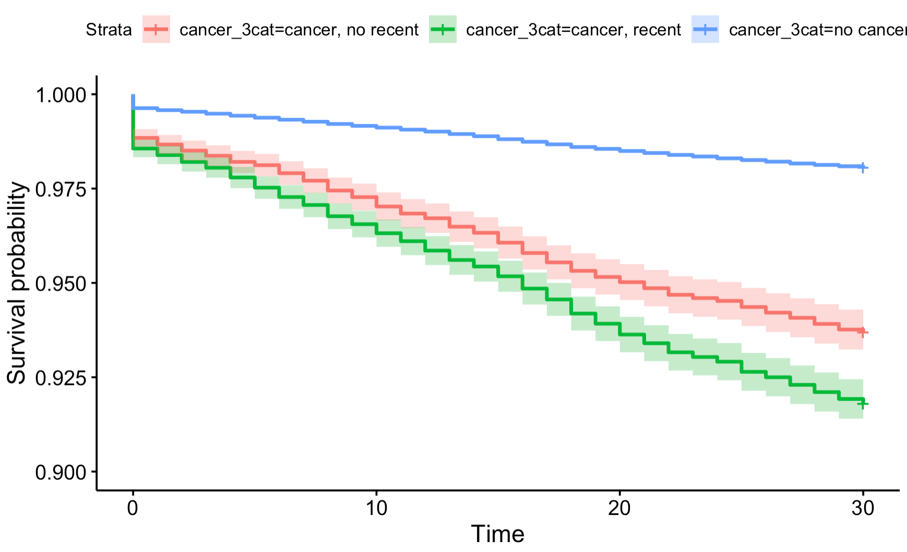
Before matching
After matching

Slide 23
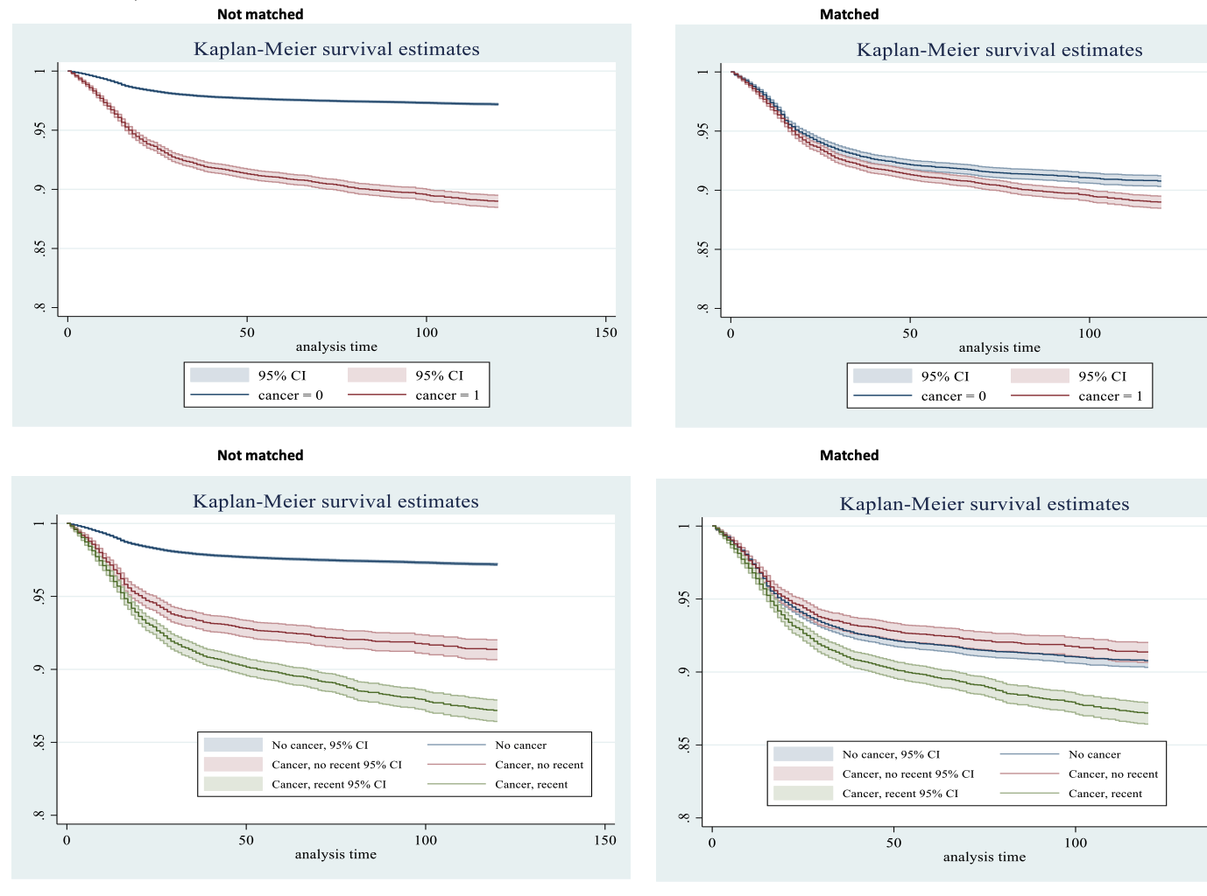

Slide 24
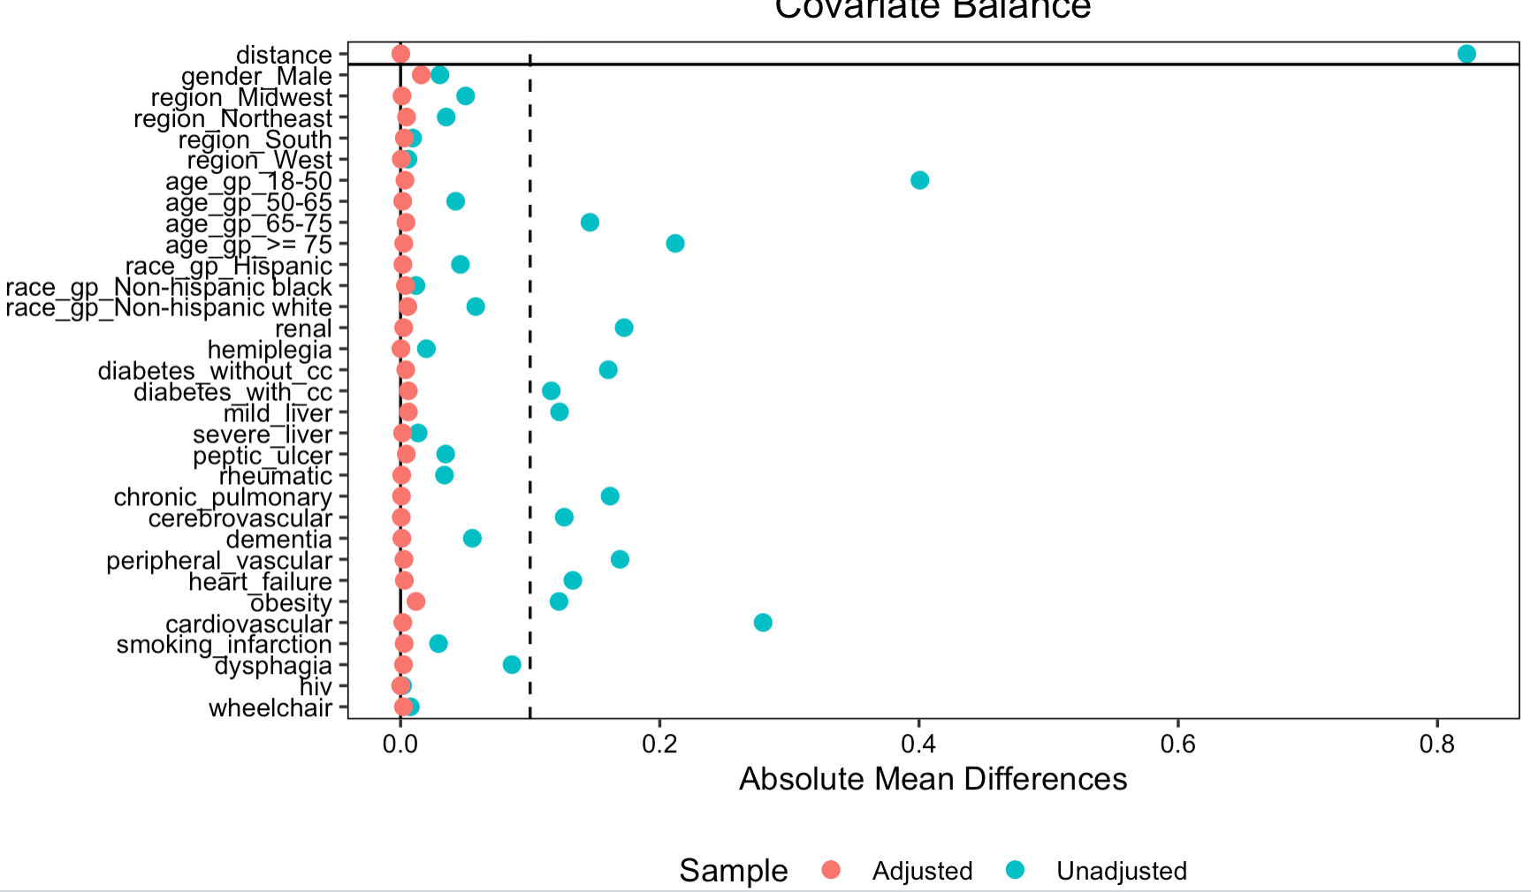
Deviation

Slide 25
Time_to_event in survival analysis used is defined by Dr. Zhu
Race/age categorization rule is little bit different
Other/Unknown is treated as missing

Slide 26
Cancer subgroup analysis

